Slide 1
Information Security Incident Handling
Webinar 4
Countermeasures, Architecture and Incident Reporting
Jeremy Koster

Slide 2
Brief Recap
Malware – viruses, worms, spyware, adware, scareware and trojans
Web application and database attacks
Phone system and remote access attacks
Avoiding detection
Countermeasures
Network and system monitoring tools
Information Security Architecture

Slide 3
Principles
Remove the asset
Authenticate, authorise and audit
Separation of duties
Separate operational aspects of a system – no God account
Prevent collusion
Increase governance
Orderly failure / fail safe
Firewall, IDS, WAF flooding
Policy and training
Adaptive enhancement
Controls increase in strength as the environment changes
Simple cheap and easy – KISS, do the basics
Path of least resistance

Slide 4
Defence in Depth
Identify the path an attacker has to traverse
Apply controls at several layers
Physical sites
Networks
Servers
Desktops
Virtual systems
Portable devices
Applications
Databases

Slide 5
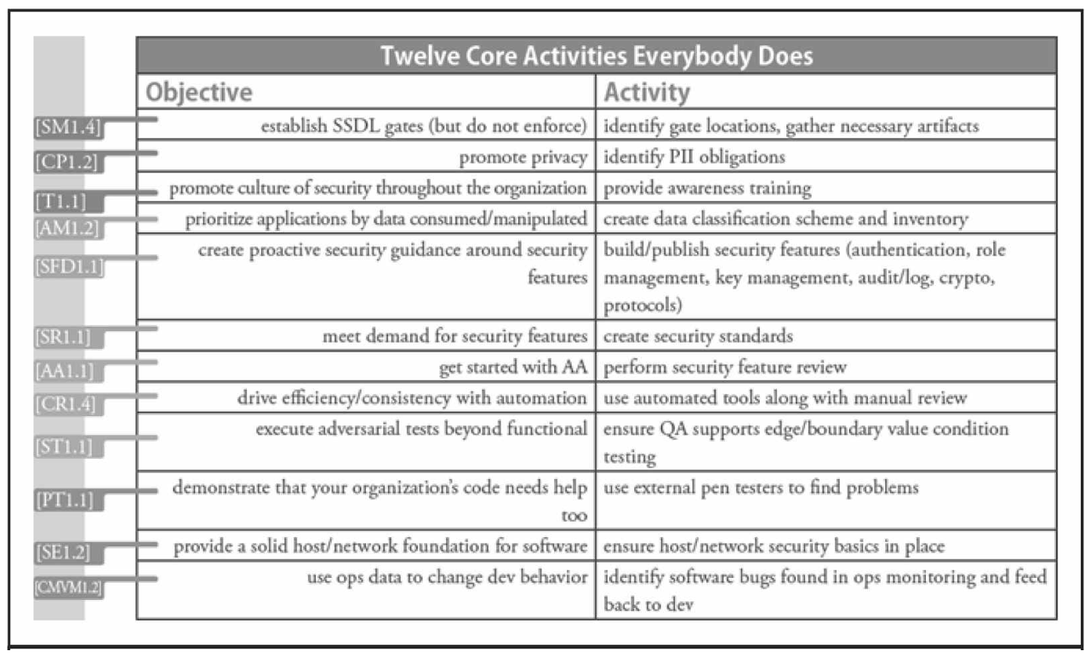
Align with Industry Recommendations
ASD Top 35 (top 4)
Application whitelisting
Application patching
Operating system patching
Restrict administrator privileges
SANS Top 20
Inventory of devices and software
Secure configurations
Vulnerability assessment and remediation
Malware defences
BSIMM
3 year study of top practitioners activity

Slide 6
Password Security
Strong passwords
Length
Complexity
Passphrases
Password processes
Password reset process
Account lockout
Password expiry (history and change frequency)
Technology
Strong hashing
Salting

Slide 7

Malware Protection
Antimalware / antivirus
Real-time scanner
Regular scans
Signature updates
Multiple definitions
HIPS
System and file monitoring
Network virus signature
Gateway scanning
Web proxy
SMTP gateway
Virtualisation / sandboxing

Slide 8
Sniffing and Session Hijacking
Switched networks
Separate broadcast domains
Port security
Monitoring
Encryption in transit
SSL
IPSec
Strong authentication protocols
Avoid unencrypted protocols
Eradicate LanMan hash
Protect DNS services

Slide 9
Denial of Service
Scrubbing systems
Identify attack traffic
Send through clean traffic
Cloud services
BGP or DNS changes
Global presence
Web application firewalls
Filter out slow attacks

Slide 10
Buffer Overflow Protection
Secure coding practices
Automated review
Peer review
External scanning
Patching
Patching cycles
Emergency patching
Web application firewalls
Filter out malicious traffic

Slide 11
Web Application Countermeasures
OWASP
Provide guidelines and frameworks for web application security
Famous for the OWASP Top Ten
Top ten
Injection
Broken authentication
Cross-site-scripting
Insecure direct object reference
Security misconfiguration

Slide 12
Portable Devices and Mobile Security
Remote access
Access from anywhere immediately
Local copies to aid in fast view low bandwidth
Transport encryption
Dual factor authentication (no split tunnelling)
Roaming assets
Laptops, tablets, smartphones
WiFi Hotspots
Home workers
Encryption
PIN access
Remote wipe
NAC

Slide 13
Cloud Controls
3rd party security posture
Encryption of data
User management
Application security
Development security
Privileged user access
Network zoning
Server security
SaaS
PaaS
IaaS

Slide 14

People and Process
Project governance
Provide requirements
Review design
Security tests
Incident response
Handle incidents
Report
3rd party governance
Review new 3rd parties
Periodically review
Awareness
Training
Spot tests
Business continuity

Slide 15

Why Write an Incident Report?
Education
Security staff
Encourage discussion and questions
Knowledge transfer
Refine
Process
Contacts
Be Prepared
When the big incident occurs
Compliance
PCI

Slide 16
Trust, trust and more trust
Confidence in the Information Security team
Go-to-guys when another incident occurs
Go-to-guys when large initiatives are planned
Seen as protectors rather than road-blocks
Strategic recommendations lead to sponsorship which leads to budget
Cements the importance of security within the minds of the executives

Slide 17
Suggested Sections
Introduction
Timeline of events and actions
Technical analysis and risk assessment
Organisational response
Recommendations
Contact list

Slide 18
Introduction
Intent
Explain to the non-technical
What happened
Why did it happen
When did it start, when was it resolved
The bottom line – the damage that occurred
Language
No jargon – nothing should need particular explanation
Logical sentences that are not too long
No conditional statements (weakens the flow of the paragraph)
Balance between technical and non-technical
Sacrifices have to be made – stick to the main thrust

Slide 19
Timeline of Events and Activities
Events
Start of incident
Date and time the particular asset was no longer at risk
Date and time the incident was closed (no further risk)
Activities
Date and time that the incident was recognised
Date and time that the incident was reported to the incident handling team
Date and time responsible technical resources (internal and external) where requested to perform remediation
Date and time that corrective controls where implemented
Actions of the implicated staff member or external person

Slide 20
Technical Analysis and Risk Assessment
More in-depth discussion of technical events
Overall incident analysis
Diagram of incident occurrence with indicators of sequence
What were the compounding issues that lead to the incident
Issues with communication or response times
Is there a particular aspect of the incident that is notable?
Has there been a previous similar incident?
Particular risks
Any risks that need the attention of the executive?
Risks of reoccurrence
Risks with particular business practices
Environmental and architectural risks
Risks experienced by competitors and industry partners
Risks pertaining to staff awareness

Slide 21
Organisational Response
Successes and failures
How did the organisation respond to the incident?
What was done well, and what needs work?
Information security team / incident response team
Delay in contact, communications channel, response
First recommendations given
Effective and ineffective controls applied
Front liners
Awareness of incident identification and reporting
Communications with customers
Public relations
Was there a need to coordinate communications with the media
Legal / law enforcement
Did the legal team get involved?
Was there any direction from Government?
Executive
When were the executive made aware?
Where there any directives provided during the incident?

Slide 22
Recommendations
Tactical
What can mitigate the risk in and can be implement now or within a week?
Block firewalls, human resources, education, process
Channels of communication
Change business practices
Strategic
What fundamentally needs to change?
Are there any large scale security controls that need to be planned, budgeted and implemented?
Are there organisational changes that need to occur?

Slide 23
Contact List
Referenced through the timeline
Ties a person through the document to a phone number and email address
Keeps a record of who the key players were
Good for lessons learned
Allows new hires to familiarise themselves with key staff

Slide 24
Releasing the Report
Release it fast
Peer review
Versions < 1.0 for internal review
Versions > 1.0 for release beyond the information security team
Only to those who “need to know”
Senior management
Incident handlers
Tactical staff
Strategy staff
Subsequent reports
Refer back to previous incidents
Include in annual wrap-up report
Filing
Easy to find
Consistent titles and filenames
Naming convention that denotes month and incident keywords

Slide 25
Discussion Questions
Why is it important to architect security controls correctly?
Why is the OWASP Top 10 good for the security of web applications?
Are cloud environments considered secure? Explain the reason for your answer.
Why is it important to produce a good incident report?
What is the difference between the recommendations section and the technical analysis section of the incident report?
Why is it a good idea to include a section in the incident report that describes the organisational response?
Why should the incident report not be distributed beyond those that have a need to know?

